Slide 1
User Manual
Student Course Registration Application
Description: This web app will serve as a course registration platform for students.
Web App developers: Fernando Maia, Qiuming Wei, Joel Giladi
Professor: Bambang Sarif
Course: CSIS-3280-002
Team-1 Aug 1st. 2020

Slide 2
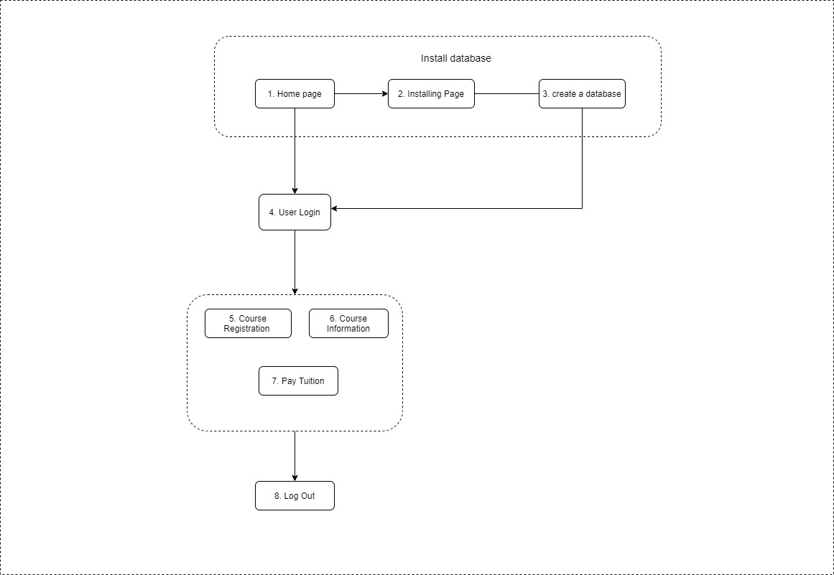
Main user flow chart
Our database consists of six entities, full CRUD operations work on students, student_courses and tuition.
Student_Courses
Students
Tuition
Courses (read-only)
Instructors (read-only)
Users (read-only)

Slide 3
Installation procedure
In order to launch the web app, extract the “Team1.zip” folder into your apache web server directory. You may use an alias, but we recommend using a virtual host.
Open Team1.php. You will see a database installation page that will ask for your connection parameters. For most users, entering Host: “localhost”, Port: “3308”, Username: “root” and no password should suffice.
Instructions
Once the database is set up, a student may enter their username and password in order to log in.
(Our current database contains 4 students. See next slide)
Once logged in, a student may view course information, register for a selected course, drop a course, and view/pay for tuition.
On the top right, there is a log out button that will sign the user out.

Slide 4
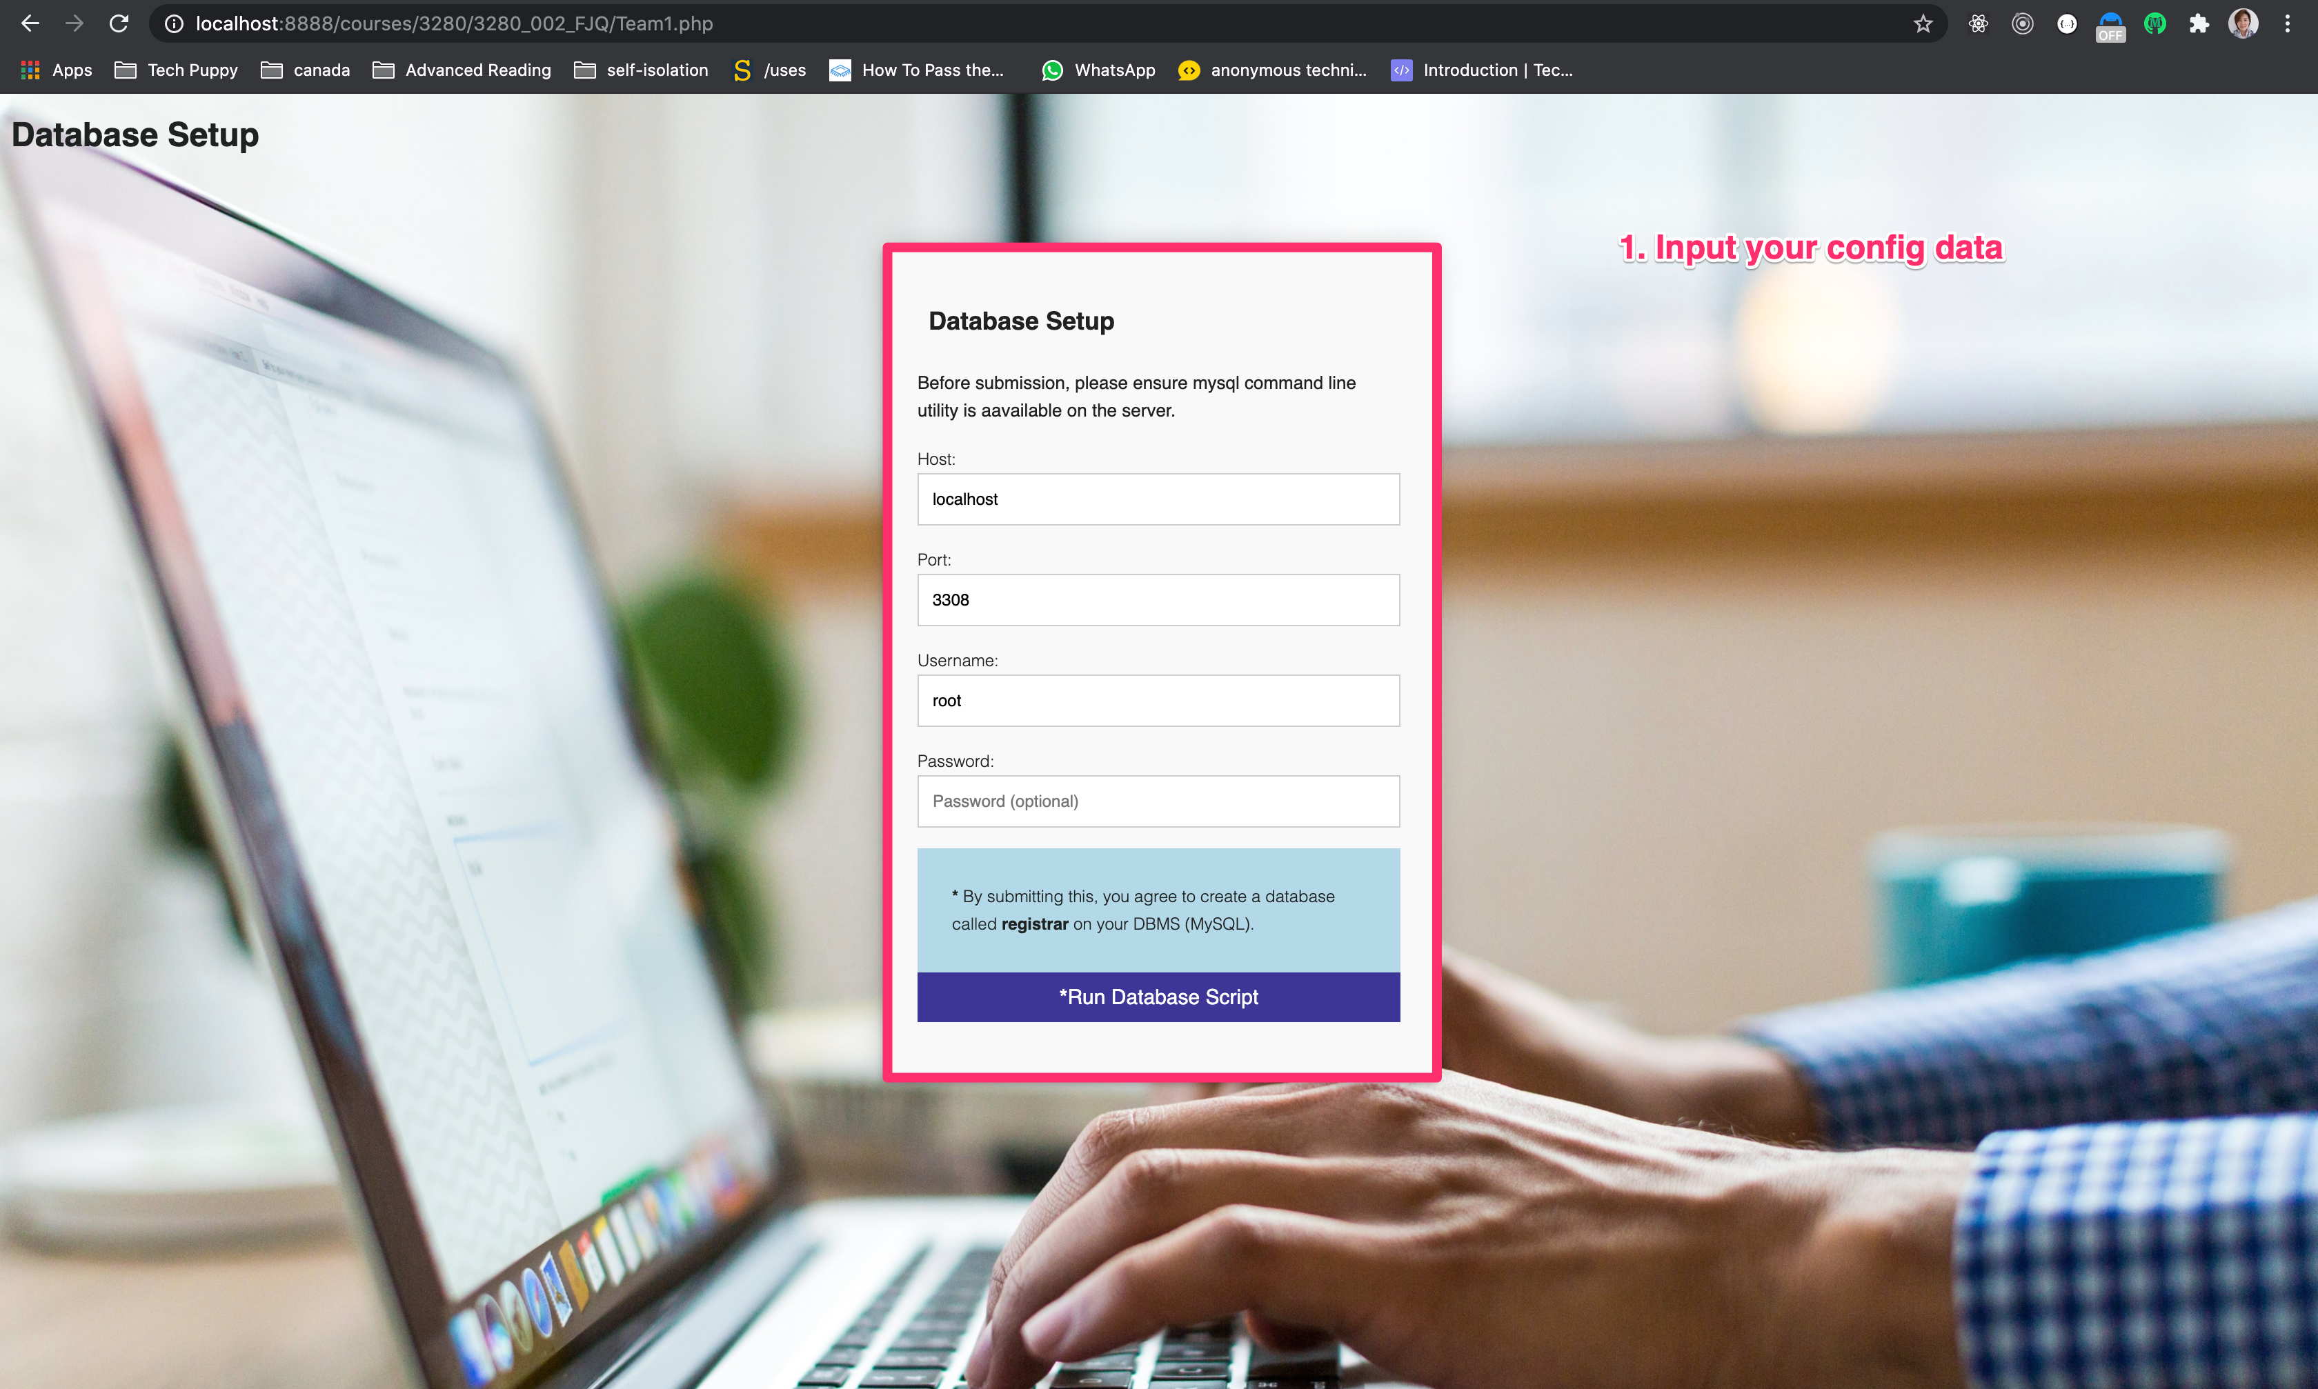
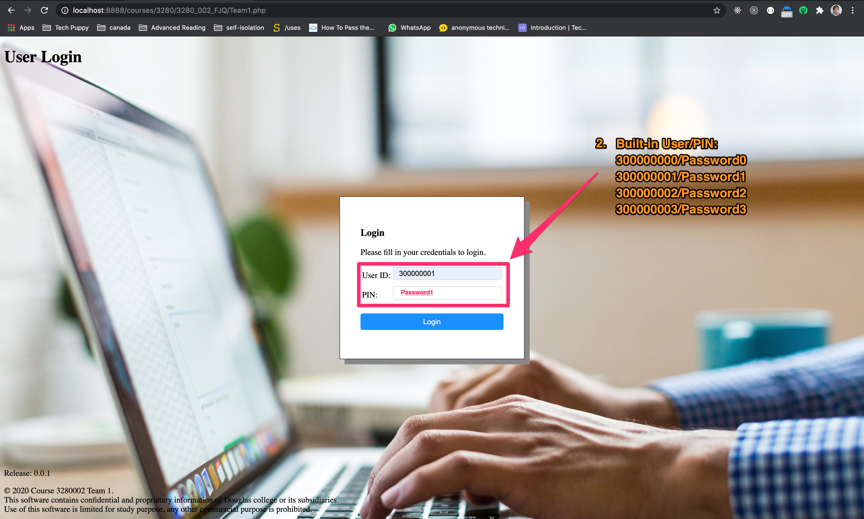
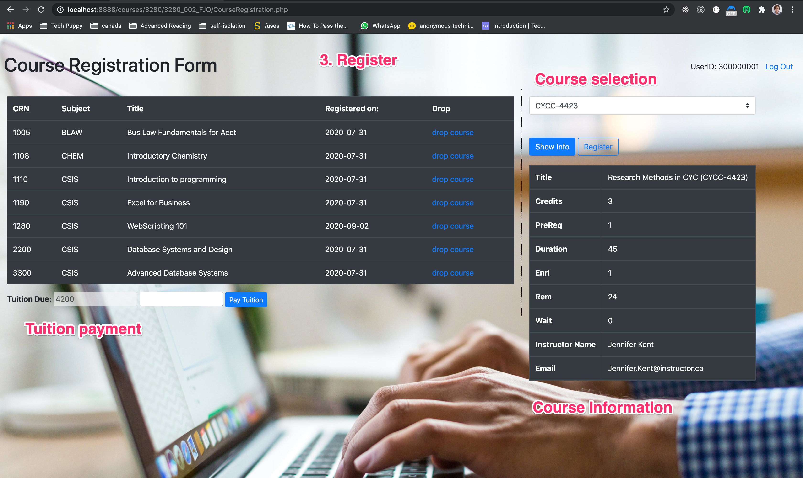
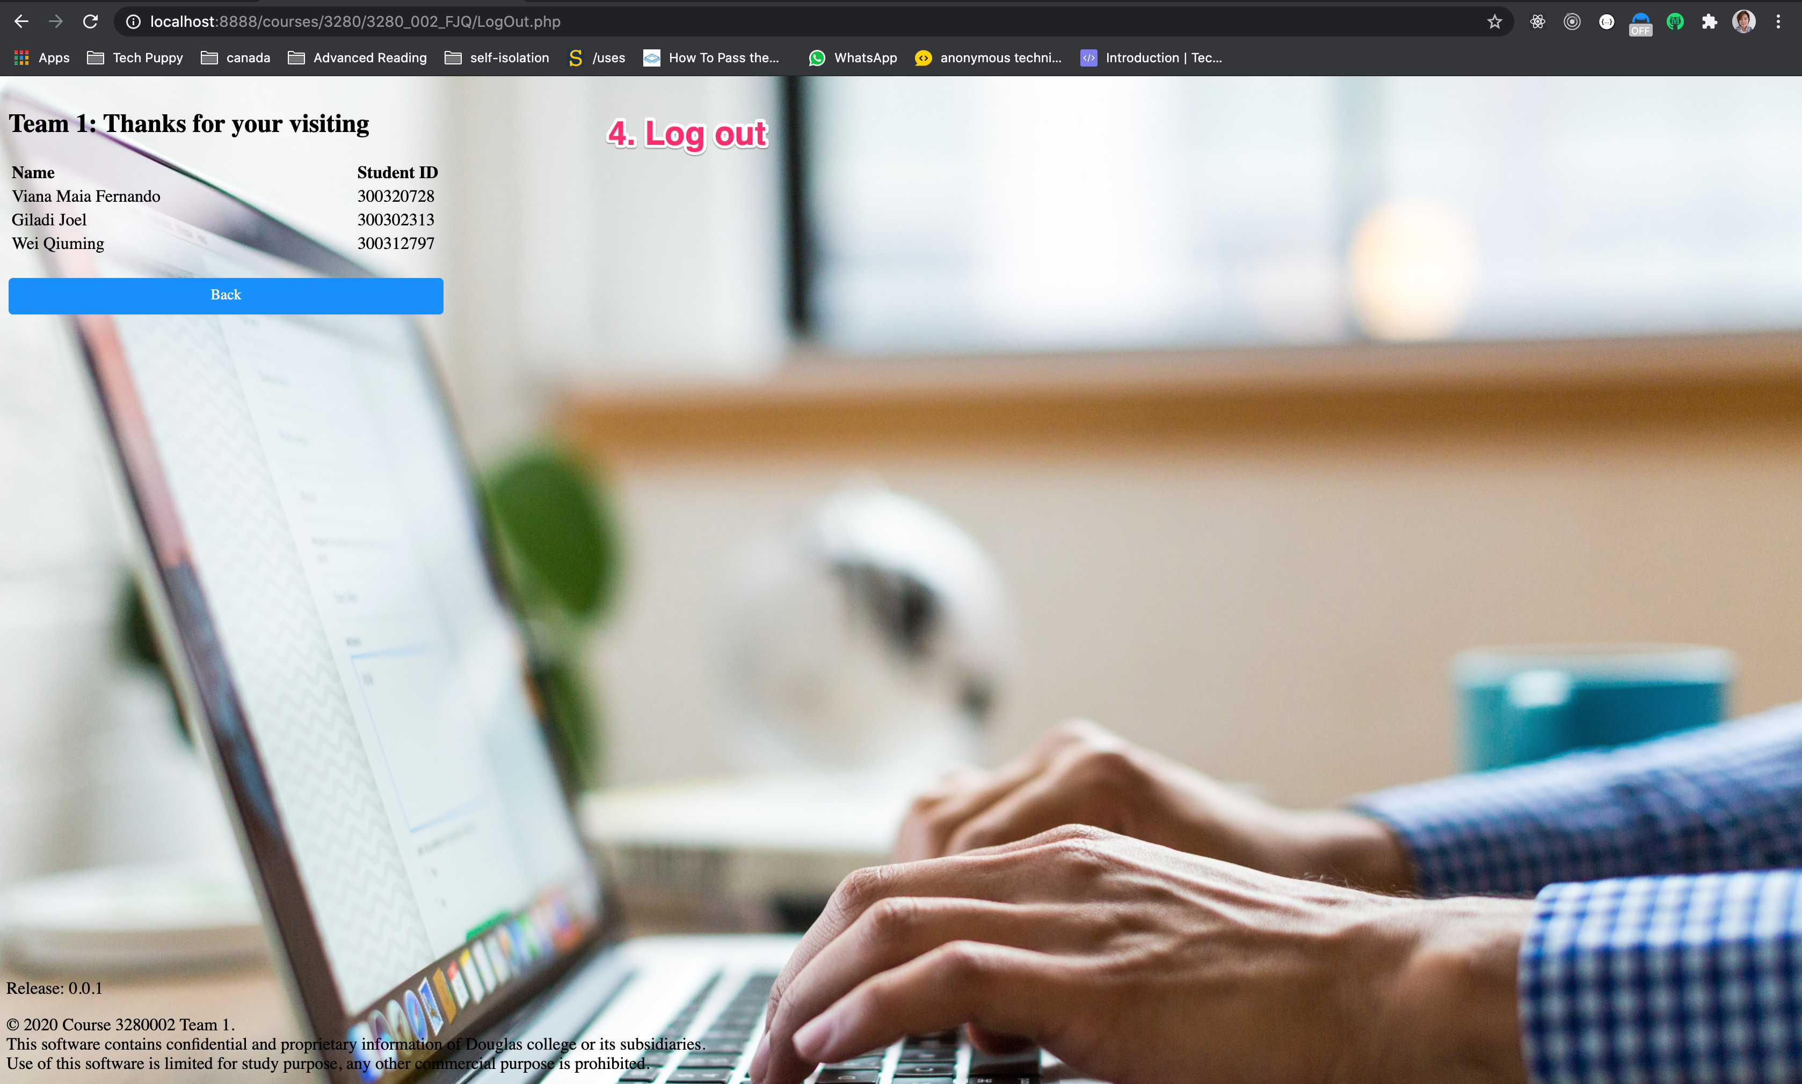
Getting Started
2. Built-in User/PIN:
300000000/Password0
300000001/Password1
300000002/Password2
300000003/Password3

